Slide 1
ASP.NET Core & ReactJS
Toni Petrina
@to_pe
Synergy, GigPin, Microsoft MVP

Slide 2


Slide 3
What is this session about?

Slide 4
Building web applications with ASP.NET Core as backend and using ReactJS on frontend

Slide 5
Is it any good?

Slide 6
The session? It's great!

Slide 7
No no, the ASP.NET Core and ReactJS, is that any good?

Slide 8
Of course.

Slide 9
So this is a SPA app, right? Is that performant?

Slide 10
Somewhat…it depends.

Slide 11
Should I use SPA for my project?

Slide 12
See answer for question 4.

Slide 13
I didn't realize that questions were numbered…

Slide 14
That is not a question.

Slide 15
Can I see it in action?

Slide 16
Sure, let's start!

Slide 17
Agenda
SPA introduction
ASP.NET Core, React, Typescript
Conclusion

Slide 18
Problems in modern web development
Templating and DOM manipulation
UI & logic decoupling (architectural patterns)
Code organization (no modules in JS)
Styles organization and preview

Slide 19
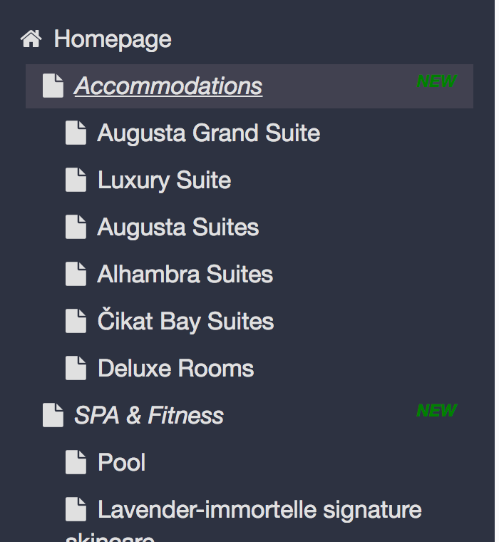
Templating…jQuery style
var root = $('#page-list-view-container');
root.empty();
app.pages.map(function (page) {
$("<a>")
.attr('href', "#")
.addClass(page.isDraft ? 'draft-page-litem' : 'published-page-litem')
.addClass('page-level-' + page.level)
.addClass(page.isDraft ? (page.isNew ? 'page-new' : 'page-draft') : 'page-published')
.attr('data-pageId', page.id)
.append($('<li>')
.text(page.name)
.prepend($('<span>')
.addClass('fa')
.addClass(page.level == 0 ? 'fa-home' : 'fa-file')
)
)
.appendTo(root);
})
addClickHandlerToSelectPages();

Slide 20
DOM manipulation
// add class selected on click
$("#page-list-view-container [data-pageid=" + selectedPageId + "]")
.find("li")
.addClass('selected')
Finding element with magic strings and concatenation
Manual update?

Slide 21
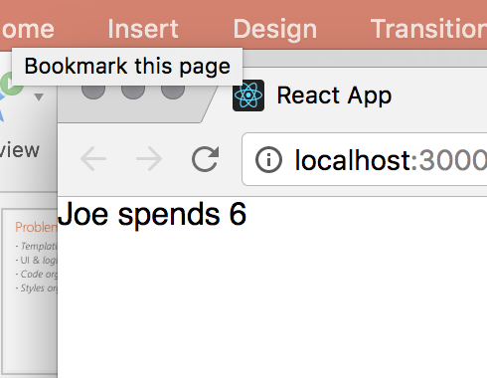
Mustache templating
var view = {
title: "Joe",
calc: function () {
return 2 + 4;
}
};
var output = Mustache.render("{{title}} spends {{calc}}", view);

Slide 22
Event handling?
var addClickHandlerToSelectPages = function () {
draftPageItem = document.getElementsByClassName('draft-page-litem'),
publishedPageItem = document.getElementsByClassName('published-page-litem');
$(draftPageItem).add($(publishedPageItem)).on('click', function (e) {
e.preventDefault();
selectedPageId = this.getAttribute('data-pageid');
history.pushState({ selectedPage: selectedPageId }, 'page ' + selectedPageId, '?selectedPage=' + selectedPageId)
selectPage(selectedPageId)
});
}

Slide 23
UI updates?
var addClickHandlerToSelectPages = function () {
draftPageItem = document.getElementsByClassName('draft-page-litem'),
publishedPageItem = document.getElementsByClassName('published-page-litem');
$(draftPageItem).add($(publishedPageItem)).on('click', function (e) {
e.preventDefault();
selectedPageId = this.getAttribute('data-pageid');
history.pushState({ selectedPage: selectedPageId }, 'page ' + selectedPageId, '?selectedPage=' + selectedPageId)
selectPage(selectedPageId)
});
}

Slide 24
ReactJS

Slide 25
What is ReactJS?
A JAVASCRIPT LIBRARY FOR BUILDING USER INTERFACES
SPA Framework
Declarative
Functional
Component oriented
"Just a view layer"

Slide 26
Klasa: React.Component
Metode:
render
setState
componentWillMount
componentWillReceiveProps
componentDidMount
componentWillUnmount
shouldComponentUpdate
componentDidUpdate
componentWillUpdate
Properties:
state, props
JSX + virtual DOM + synthetic events
<div>
<span>{this.props.text}</span>
<button onClick={this.props.handleClick}>
Click me</button>
</div>

Slide 27
React component
Importing external modules (NPM ili lokalno)
import * as React from 'react';
export default class Header extends React.Component<any, any> {
render() {
return <h1>Title goes here</h2>
}
}
Export for other modules to see
JSX

Slide 28
HTML inside JavaScripta ECMAScript?

Slide 29
The stage

Slide 30
Glossary
.NET Core – platform
ASP.NET Core – framework
ReactJS – SPA library
JavaScriptServices – handles SPA inside ASP.NET Core/replaces Razor
Tools: npm, webpack, nuget, dotnet CLI
Concepts: Single Page App, client-side routing

Slide 31
DEMO

Slide 32
class => className
import * as React from 'react';
export default class Sample extends React.Component<any, any> {
render() {
return <h4 className="title">Sample</h4>
}
}

Slide 33
for => htmlFor
import * as React from 'react';
export default class Sample extends React.Component<any, any> {
render() {
return (
<div>
<label htmlFor="url" />
<input name="url" />
</div>
);
}
}

Slide 34
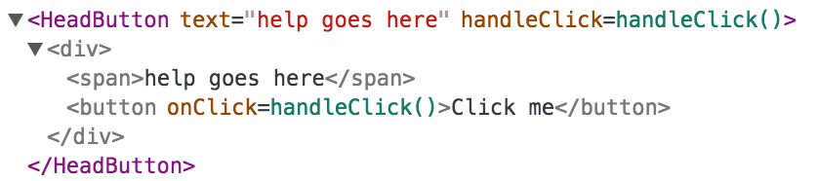
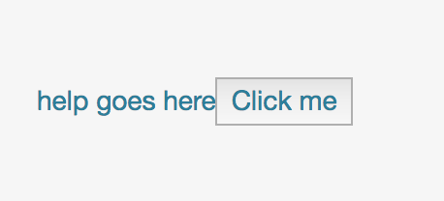
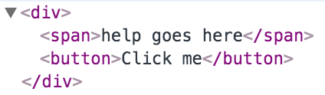
Props
class HeadButton extends React.Component<any, any> {
render() {
return <div>
<span>{this.props.text}</span>
<button onClick={this.props.handleClick}>Click me</button>
</div>
}
}
// parent component
<HeadButton text="help goes here" handleClick={e => alert('aha')} />

Slide 35
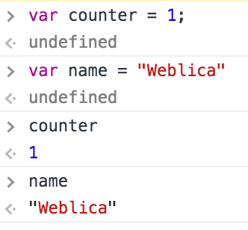
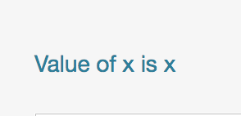


{expression}
// Evaluate
{this.props.text}
// string interpolation
{`Value of x is ${x}`}
// expressions
{isVisible ? <div /> : null}
let x = 1
//…
return (
{x}
)

Slide 36
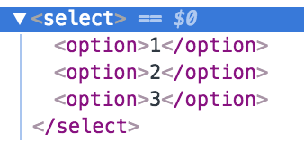
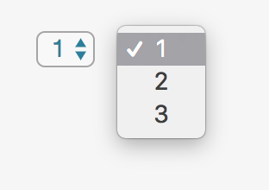
Collections
<select>
{
[1, 2, 3].map((item, index) => {
return (<option>{item}</option>);
})
}
</select>

Slide 37
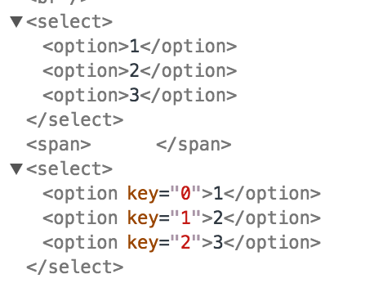
Collections + key
<select>
{
[1, 2, 3].map((item, index) => {
return (<option key={index}>{item}</option>);
})
}
</select>

Slide 38
Props aka properties
Parent -> child
Send functions as callbacks
Parent has everything child needs

Slide 39
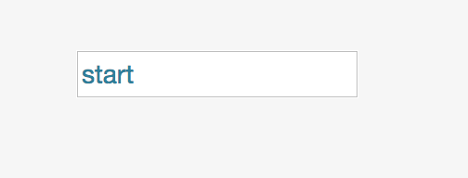
State
class Sample extends React.Component<any, any> {
constructor(props) {
super(props)
this.state = {
text: 'start'
}
}
render() {
return (
<div>
<input type="text" name="text" value={this.state.text} />
</div>
);
}
}

Slide 40
Change state?
class Sample extends React.Component<any, any> {
constructor(props) {
super(props)
this.state = {
text: 'start'
}
}
render() {
return <input type="text" name="text" value={this.state.text}
onChange={e => {
this.setState({ text: e.target.value});
}} />
}
}

Slide 41
Helper method – ES7
class Sample extends React.Component<any, any> {
constructor(props) {
//...
}
set = (e) => { // ES7
this.setState({ [e.target.name]: e.target.value })
}
render() {
return <input type="text" name="text" value={this.state.text}
onChange={this.set} />
}
}

Slide 42
State
Internal component state
Send to child components
  And to parent ones using callbacks
States should be in the lowest node possible

Slide 43
Mustache templating
var view = {
title: "Joe",
calc: function () {
return 2 + 4;
}
};
var output = Mustache.render("{{title}} spends {{calc}}", view);

Slide 44
React
import React from 'react';
import ReactDOM from 'react-dom';
var view = {
title: "Joe",
calc: function () {
return 2 + 4;
}
};
ReactDOM.render(
<span>{view.title} spends {view.calc()}</span>,
document.getElementById('root')
);

Slide 45
React
import React from 'react';
import ReactDOM from 'react-dom';
var view = {
title: "Joe",
calc: function () {
return 2 + 4;
}
};
ReactDOM.render(
<span>{view.title} spends {view.calc()}</span>,
document.getElementById('root')
);

Slide 46
React
import React from 'react';
import ReactDOM from 'react-dom';
var view = {
title: "Joe",
calc: function () {
return 2 + 4;
}
};
class App extends React.Component {
render() {
return <span>{view.title} spends {view.calc()}</span>
}
}
ReactDOM.render(
<App />,
document.getElementById('root')
);

Slide 47
React način
import React from 'react';
import ReactDOM from 'react-dom';
var view = {
title: "Joe",
calc: function () {
return 2 + 4;
}
};
class App extends React.Component {
render() {
return <span>{this.props.view.title} spends {this.props.view.calc()}</span>
}
}
ReactDOM.render(
<App view={view} />,
document.getElementById('root')
);

Slide 48
React način
import React from 'react';
import ReactDOM from 'react-dom';
var view = {
title: "Joe",
calc: function () {
return 2 + 4;
}
};
const App = ({ view }) => {
return <span>{view.title} spends {view.calc()}</span>
}
ReactDOM.render(
<App view={view} />,
document.getElementById('root')
);

Slide 49
f(state, props) = view
React in a nutshell

Slide 50
ASP.NET

Slide 51
SPA means SPA
Single page – 1 or one view index.html
Routing is client-side
Server side routing can be used for heavy lifting
Server side rendering is an option

Slide 52
JavaScriptServices
node.js se running under ASP.NET Core
webpack used for bundling
Hot Module Reload (HMR)
Typescript – optional types for JavaScript
https://github.com/aspnet/javascriptservices

Slide 53
Kako krenuti
dotnet new react
npm install
dotnet run
$env:ASPNETCORE_ENVIRONMENT="Development"

Slide 54
Dotnet watch
<DotNetCliToolReference Include="Microsoft.DotNet.Watcher.Tools" Version="2.0.0" />
dotnet watch run

Slide 55
API Controller
[Route("api/[Controller]")]
public class ListController : Controller
{
public IActionResult Get()
{
return Ok(new[]
{
new {id=1, name="john"}
});
}
}

Slide 56
componentDidMount() {
fetch("/api/list")
.then(r => r.json() as Promise<Item[]>)
.then(items => this.setState({ items: items }))
}

Slide 57
async componentDidMount() {
let response = await fetch("/api/list")
let data = await response.json()
this.setState({ items: data })
}

Slide 58
Swashbuckle
dotnet add package Swashbuckle.AspNetCore

Slide 59
Routing! react-router
export default <Route component={Layout}>
<Route path='/' components={{ body: Home }} />
<Route path='/counter' components={{ body: Counter }} />
<Route path='/fetchdata' components={{ body: FetchData }}>
<Route path='(:startDateIndex)' /> {
/* Optional route segment that does not affect NavMenu highlighting */
}
</Route>
<Route path='/sample' components={{ body: Sample }} />
<Route path='/sampleredux' components={{ body: SampleRedux }} />
</Route>;

Slide 60
app.UseMvc(routes =>
{
routes.MapRoute(
name: "default",
template: "{controller=Home}/{action=Index}/{id?}");
});
// here you can see we make sure it doesn't start with /api, if it does, it'll 404 within .NET if it can't be found
app.MapWhen(x => !x.Request.Path.Value.StartsWith("/api"), builder =>
{
builder.UseMvc(routes =>
{
routes.MapSpaFallbackRoute(
name: "spa-fallback",
defaults: new { controller = "Home", action = "Index" });
});
});

Slide 61
EntityFrameworkCore
dotnet add package Microsoft.EntityFrameworkCore.SqlServer

Slide 62
Misc

Slide 63
Redux
Complex state management

Slide 64
Refactoring to Redux
class Account {
loadAccountInfo (accountId) {
isFetching = true
axios.get(`/api/accounts/${window.userState.accountId}`)
.then(r => {
isFetching = false
data = r.data
})
.catch(e => {
isFetching: false
alert('Error fetching account details')
})
}
}

Slide 65
Refactoring to Redux
loadAccountInfo = (accountId) => {
this.setState({ isFetching: true });
axios.get(`/api/accounts/${accountId}`)
.then(r => {
this.setState({ isFetching: false })
this.setState(r.data)
})
.catch(e => {
this.setState({ isFetching: false })
alert('Error fetching account details'));
})
}

Slide 66
Refactoring to Redux
loadAccountInfo = (accountId) => {
this.setState({ isFetching: true });
axios.get(`/api/accounts/${accountId}`)
.then(r => {
this.setState({ isFetching: false })
this.setState(r.data)
})
.catch(e => {
this.setState({ isFetching: false })
alert('Error fetching account details'));
})
}

Slide 67
Refactoring to Redux
const loadAccountInfo = (accountId) => (dispatch, getState) => {
dispatch({ type: 'ACCOUNT_LOAD_START' });
axios.get(`/api/accounts/${accountId}`)
.then(r => {
dispatch({ type: 'ACCOUNT_LOAD_SUCCESS', data: r.data })
})
.catch(e => {
dispatch({ type: 'ACCOUNT_LOAD_FAIL', data: r.data })
alert('Error fetching account details')
})
}

Slide 68
Refactoring to Redux
const loadAccountInfo = (accountId) => (dispatch, getState) => {
dispatch({ type: 'ACCOUNT_LOAD_START' });
axios.get(`/api/accounts/${accountId}`)
.then(r => {
dispatch({ type: 'ACCOUNT_LOAD_SUCCESS', data: r.data })
})
.catch(e => {
dispatch({ type: 'ACCOUNT_LOAD_FAIL', data: r.data })
alert('Error fetching account details')
})
}

Slide 69
Refactoring to Redux
const reducer = (state = initialState, action) => {
switch (action.type) {
case 'ACCOUNT_LOAD_START':
return {
...state,
isFetching: true }
case 'ACCOUNT_LOAD_SUCCESS':
return {
...state,
isFetching: false }
case 'ACCOUNT_LOAD_FAIL':
return {
...state,
isFetching: false }
}
return state
}
const initialState = {
isFetching: false,
data: null
}

Slide 70
Conclusion (free will is an illusion)
ASP.NET Core is a great choice
SPA framework makes creating apps easier
  React is one of the SPA frameworks out there (the best one)
Typescript helps a lot
Create reusable components

Slide 71

Toni Petrina
Massive Pixel d.o.o.
@to_pe
toni@massivepixel.co

